Slide 1
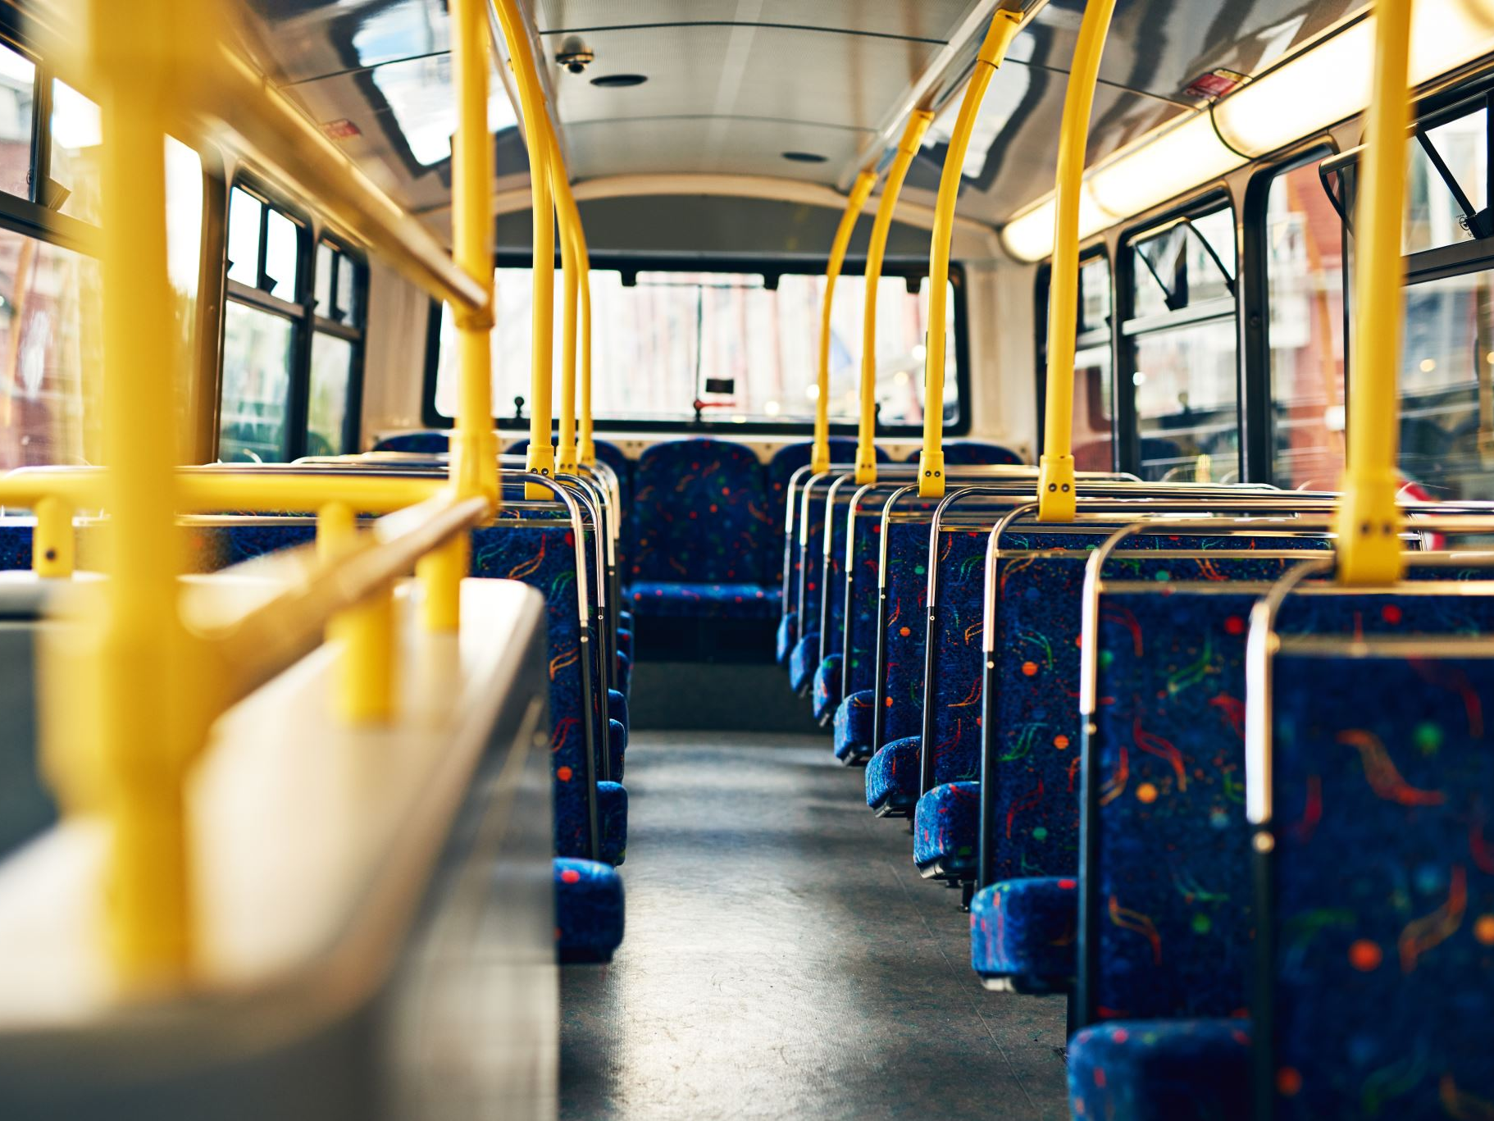
ROUTE OPTIMIZATION OF URBAN PUBLIC TRANSPORTATION
Operations Analytics DAMO 610 - 1
Presented By: Setu Chaudhari, Heta Chavda, Enejo David Colonel
University Of Niagara Falls, Canada
Winter 2025

Slide 2
Problem Description: Public Bus Scheduling Challenges
- Passenger demand fluctuates during peak and off-peak hours.
- Traffic congestion affects bus arrival times and efficiency.
- Inefficient scheduling leads to increased operational costs.
- Environmental concerns: fuel consumption and emissions.
**Objective:** Develop an optimized bus scheduling system to enhance efficiency and reduce costs.

Slide 3
Methodology: Optimization Model
**Steps in the Optimization Approach:**
1. Define costs, routes, and constraints.
2. Develop a Mixed Integer Programming (MIP) model.
3. Implement the model using Google OR-Tools.
4. Solve and analyze results using synthetic data.
**Key Techniques Used:**
- Integer Linear Programming (ILP)
- Traffic & Demand Data Integration
- Python for Algorithm Implementation

Slide 4
Mathematical Model for Bus Scheduling
Decision Variables:
X_ij: Bus assignment between stops i and j.
T_od: Transfer cost from origin o to destination d.
C_ij: Travel cost between stops i and j.
E_r: Emissions per bus route r.
Objective Function:
Minimize total cost, transfers, and emissions:
min Σ C_ij X_ij + λ1 Σ T_od + λ2 Σ E_ij
Constraints:
Fleet Size Limitation
Passenger Demand Satisfaction
Traffic Congestion Adjustment

Slide 5
Python Implementation Using Google OR-Tools
from ortools.linear_solver import pywraplp def optimize_bus_scheduling(): solver = pywraplp.Solver.CreateSolver('SCIP') num_stops = 5 cost_matrix = [[0, 10, 15, 30, 25], [10, 0, 20, 35, 40], [15, 20, 0, 25, 30], [30, 35, 25, 0, 15], [25, 40, 30, 15, 0]] num_buses = 3 max_transfers = 2 X = {} for i in range(num_stops): for j in range(num_stops): if i != j: X[i, j] = solver.BoolVar(f'X[{i},{j}]') solver.Minimize(solver.Sum(cost_matrix[i][j] * X[i, j] for i in range(num_stops) for j in range(num_stops) if i != j)) status = solver.Solve() if status == pywraplp.Solver.OPTIMAL: print('Optimal solution found')

Slide 6
Project Findings: Key Observations
- Optimized scheduling reduces unnecessary travel costs.
- Demand-based bus allocation improves passenger satisfaction.
- Real-time traffic data helps avoid congestion delays.
- Emission control strategies promote sustainable transportation.
**Outcome:** A data-driven approach significantly enhances scheduling efficiency.

Slide 7
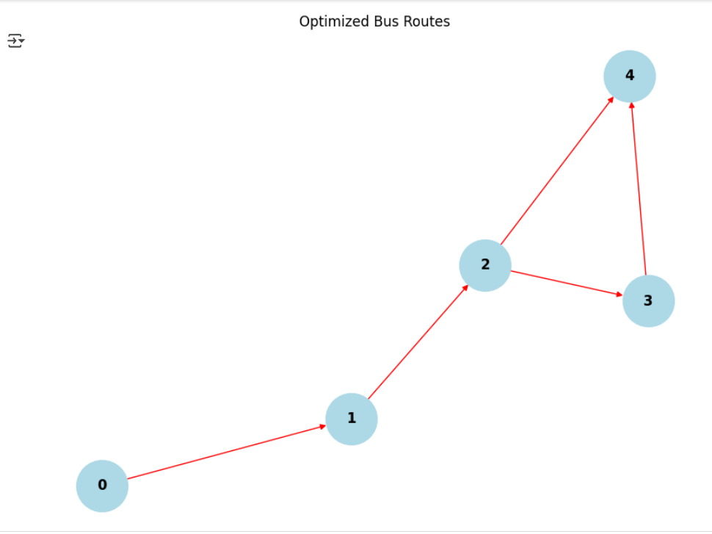
Results & Visualizations
Route Visualization Using NetworkX and Matplotlib
Nodes (Circles) represent bus stops, and edges (Lines) represent assigned bus routes.
Optimized routes reduce unnecessary transfers, ensuring efficient connectivity.
Color-coded paths highlight traffic congestion or route priorities for better planning.
Helps identify bottlenecks and improve bus allocation based on passenger demand.

Slide 8
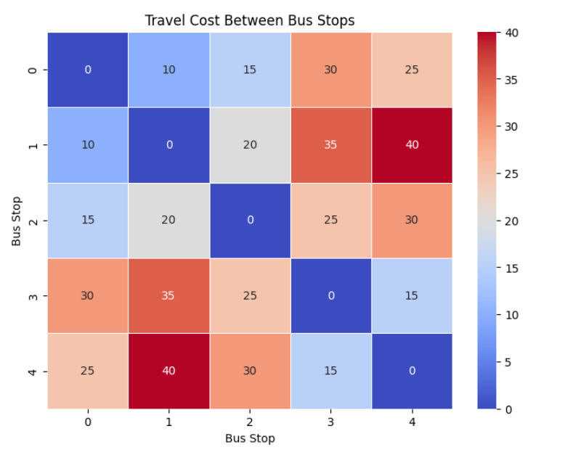
Results & Visualizations
Heatmap of Travel Costs Using Seaborn
Heatmap of Travel Costs Using Seaborn
Shows travel costs between bus stops using color intensity (darker = higher cost).
Identifies expensive routes that may need optimization.
Helps reduce operational expenses by rerouting buses efficiently.
Improves passenger affordability by minimizing high-cost travel paths.

Slide 9
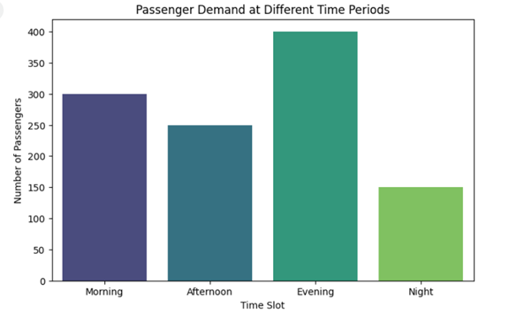
Results & Visualizations
Bar Chart of Passenger Demand Over Time
Displays passenger volume at different times of the day (Morning, Afternoon, Evening, Night).
Ensures more buses during peak hours and avoids unnecessary trips in low demand.
Balances fleet allocation to reduce overcrowding and idle buses.
Enhances passenger experience with optimized bus availability.

Slide 10
Conclusion
Optimized scheduling significantly reduces costs by minimizing unnecessary routes and improving fleet allocation.
Passenger experience is enhanced through reduced wait times, fewer transfers, and better demand-based scheduling.
Integration of real-time traffic data and AI-driven demand forecasting ensures adaptability to urban transit challenges.
Sustainable transport planning is achieved by reducing fuel consumption, lowering emissions, and enhancing eco-friendly operations.
Future enhancements include GPS-based live tracking and multi-objective optimization to further improve efficiency and service quality.

Slide 11

Thank you

